Slide 1
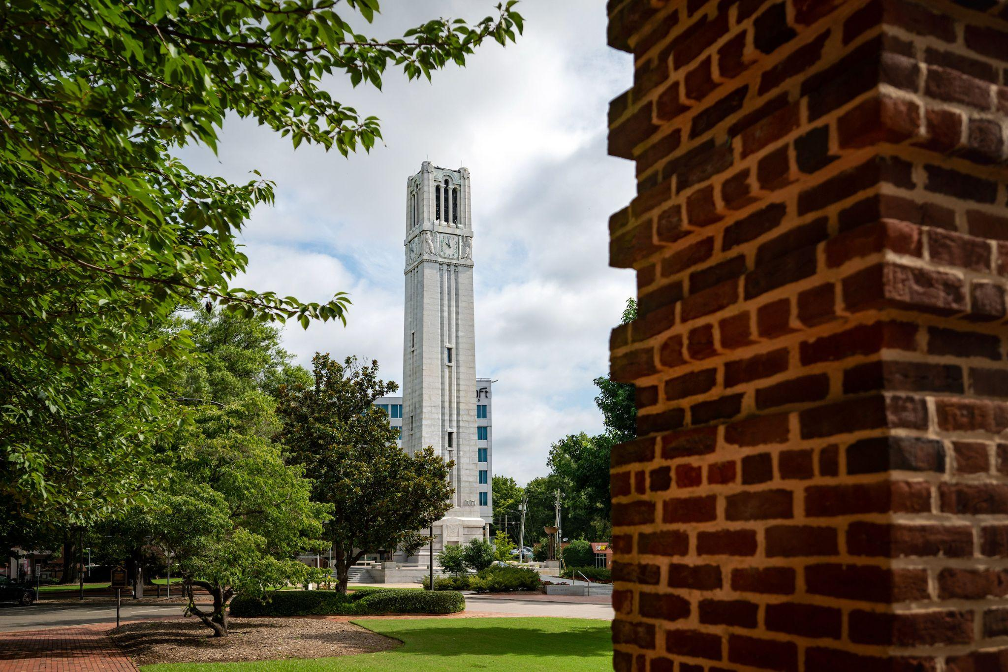
J-1 Scholar Check In
Office of International Services
NC State University

Slide 2
Today’s Agenda
The Office of International Services (OIS)
Immigration Information
Life in the US and at NC State

Slide 3
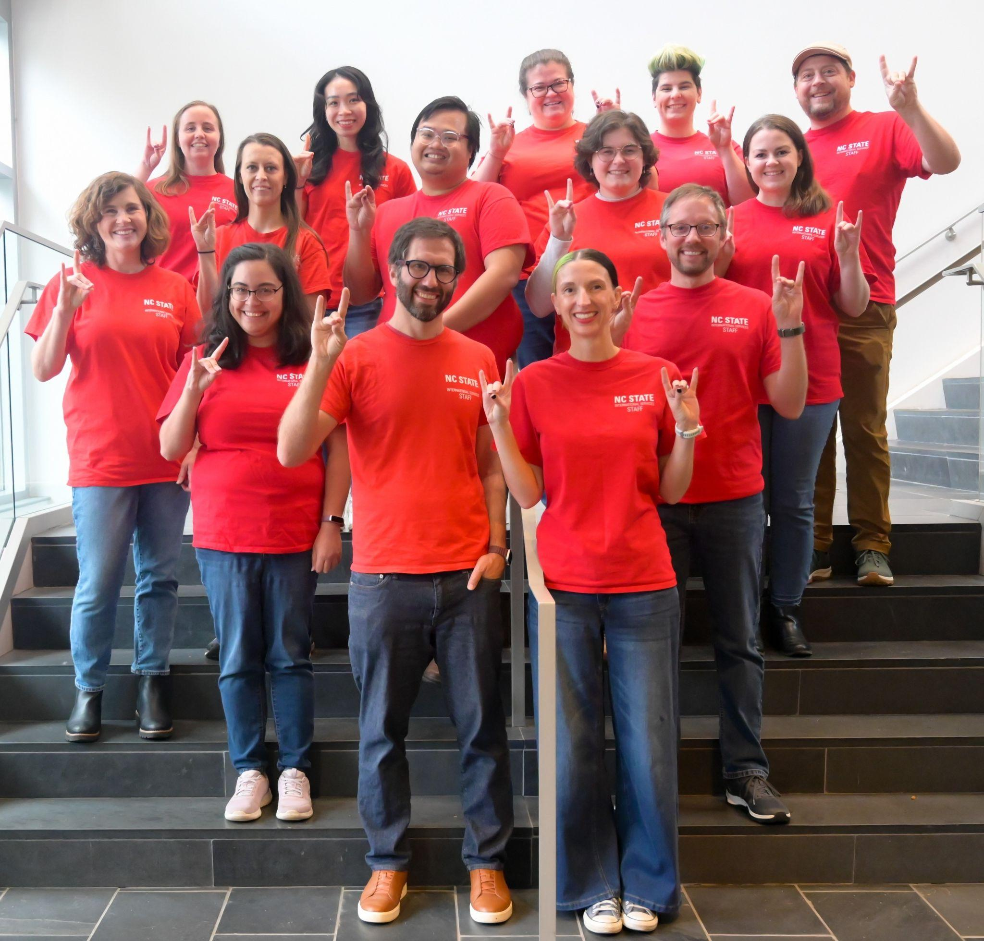
Role of the
Office of International Services (OIS)
Administers NC State University’s J-1 Exchange Visitor Program and the F-1 student program.
Advises international students and scholars about immigration regulations.
Represents NC State University on campus and in the community.

Slide 4
The OIS Team
Elizabeth James – Director
Lauren Ball – Associate Director, Programs
Mike Shurer – Associate Director, SEVIS Compliance
Hillary Patton – Associate Director, Advising
Courtenay Klauber – Senior Int’l Student & Scholar Advisor
Thor Duryea – Senior Int’l Student & Scholar Advisor
Ray Espinol – Senior Int’l Student & Scholar Advisor
Elizabeth Bender – Int’l Student & Scholar Advisor
Jennifer Glass- Int’l Student & Scholar Advisor
Mindy Dunkin - Int’l Student & Scholar Advisor
Kathryn Behling - Data & Compliance Analyst
Maggie Harney- Programs Coordinator
Kait Diova - Intake Specialist
Tony Shurer- Academic Coordinator for International Student Support
Le To - Sponsored Student Program Manager
Notes:
OIS by the Numbers : Lets them know they are part of a large community AND so they understand our caseload.

Slide 5
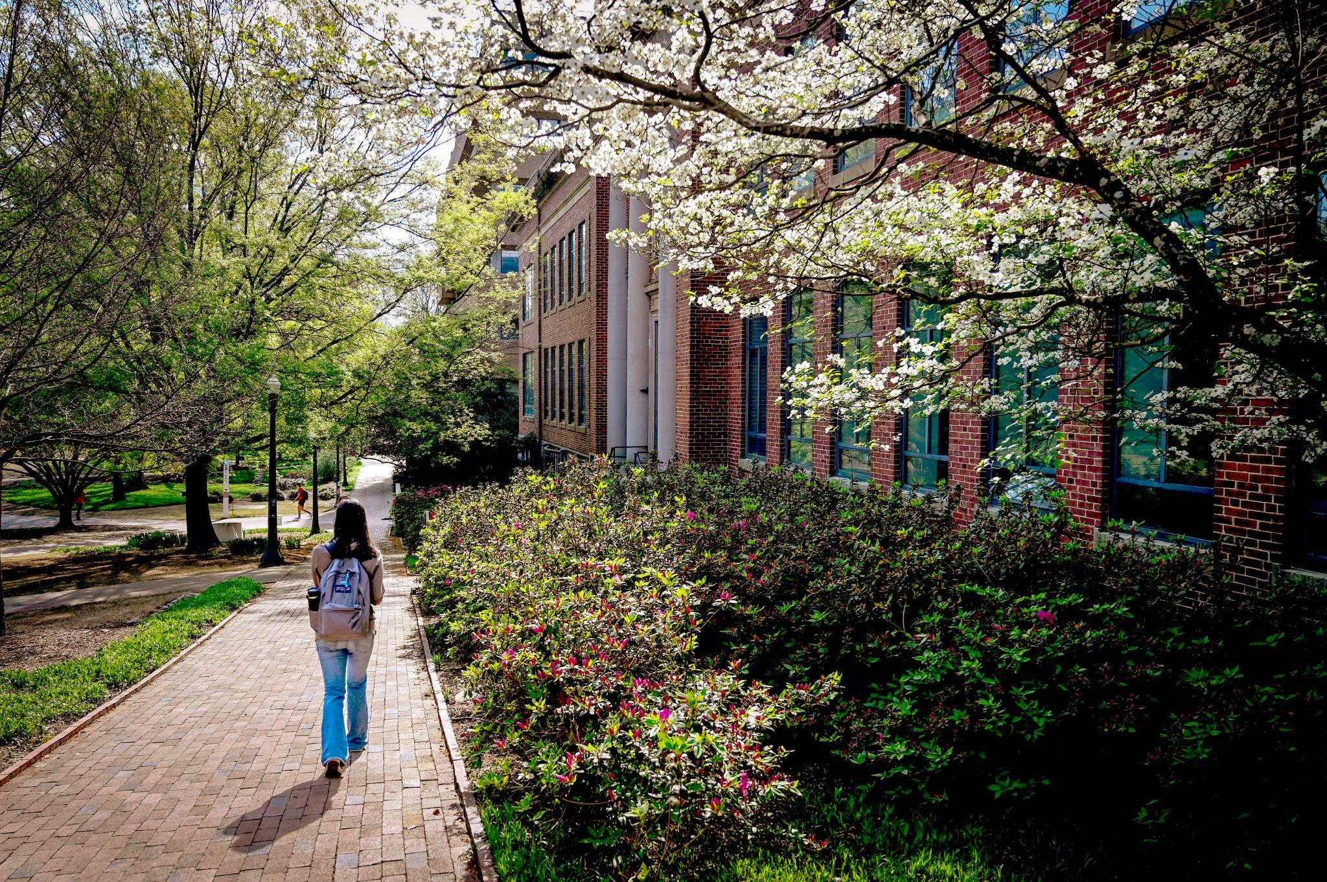
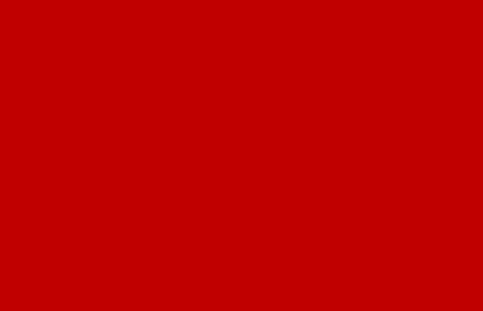


How to Contact Us
OIS Website
NEW OFFICE!
3rd Floor of Page Hall
21 Current Drive
PROCESSING TIME
up to…
Email Response:
3 business days
New Document:
10 business days
CONTACT US
919-515-2961
ois@ncsu.edu
Notes:
***Important to stress here that access to our physical office is by appointment only currently but that we’re working the same hours and still just as accessible (virtually) for scholars.
Remind scholars we process requests and respond to emails on a first-in, first-out basis to be fair to everyone.
We recognize that sometimes there are emergencies and for urgent cases, especially things like family emergencies or circumstances out of anyone’s control, and we do prioritize these. If you are having an emergency, the best way to get in touch is a phone call or virtual advising hours. If scholars have an inquiry that may take more than 5 minutes to discuss and is not an emergency, they should schedule an appointment.

Slide 6

Immigration Information
Next, we will discuss the purpose of the J-1 Visa and the set of regulations which must be followed for this visa status.

Slide 7
Important Terms & Documents

Slide 8
Important Terms Pt. 1
Immigration Status | A person’s legal presence in the United States.
J-1 | Can refer to a visa or an immigration status. A person who enters the US with a J-1 visa is given J-1 status and is known as an exchange visitor.
J-1 Category | Within the J-1 immigration status, there are multiple categories such as student, research scholar, student intern, etc. Each of these categories has its own rules that must be followed in order to comply with the terms of the visit. The J-1 category can be found in section 4 on the DS-2019.
J-1 Program | The planned group of activities in which a J-1 exchange visitor is engaged for a specific purpose and a specific time period as documented on the DS-2019.
Maintaining Status | The process of following the rules of one’s immigration status and J-1 category.

Slide 9
Important Terms Pt. 2
SEVIS | The Student and Exchange Visitor Information System is a data collection and monitoring system used by universities, the Department of Homeland Security, US consulates and embassies, and ports of entry. Each J-1/J-2 visitor has a SEVIS record with a unique SEVIS ID number. NCSU is required to update SEVIS whenever a change occurs in a J-1 exchange visitor’s program.
Grace Period | The 30 day period after end date on the DS-2019. This is given automatically. During the grace period you can: prepare to leave the US say goodbye to friends and pack your things travel within the US During the grace period, you cannot: work or do research! leave the US and re-enter request an extension (once your DS-2019 expires, it is too late)
Terminate | The action NCSU must take (required by the regulations) to end an individual’s J-1 program in SEVIS if the individual commits certain immigration violations. Termination requires the individual (and any dependents) to depart the US immediately.

Slide 10

Important Documents: Passport
Maintain a valid passport – valid 6 months into the future at all times.
You can renew your passport with your home country’s embassy in the US
Find your nearest embassy at www.embassy.org (opens in new tab).

Slide 11
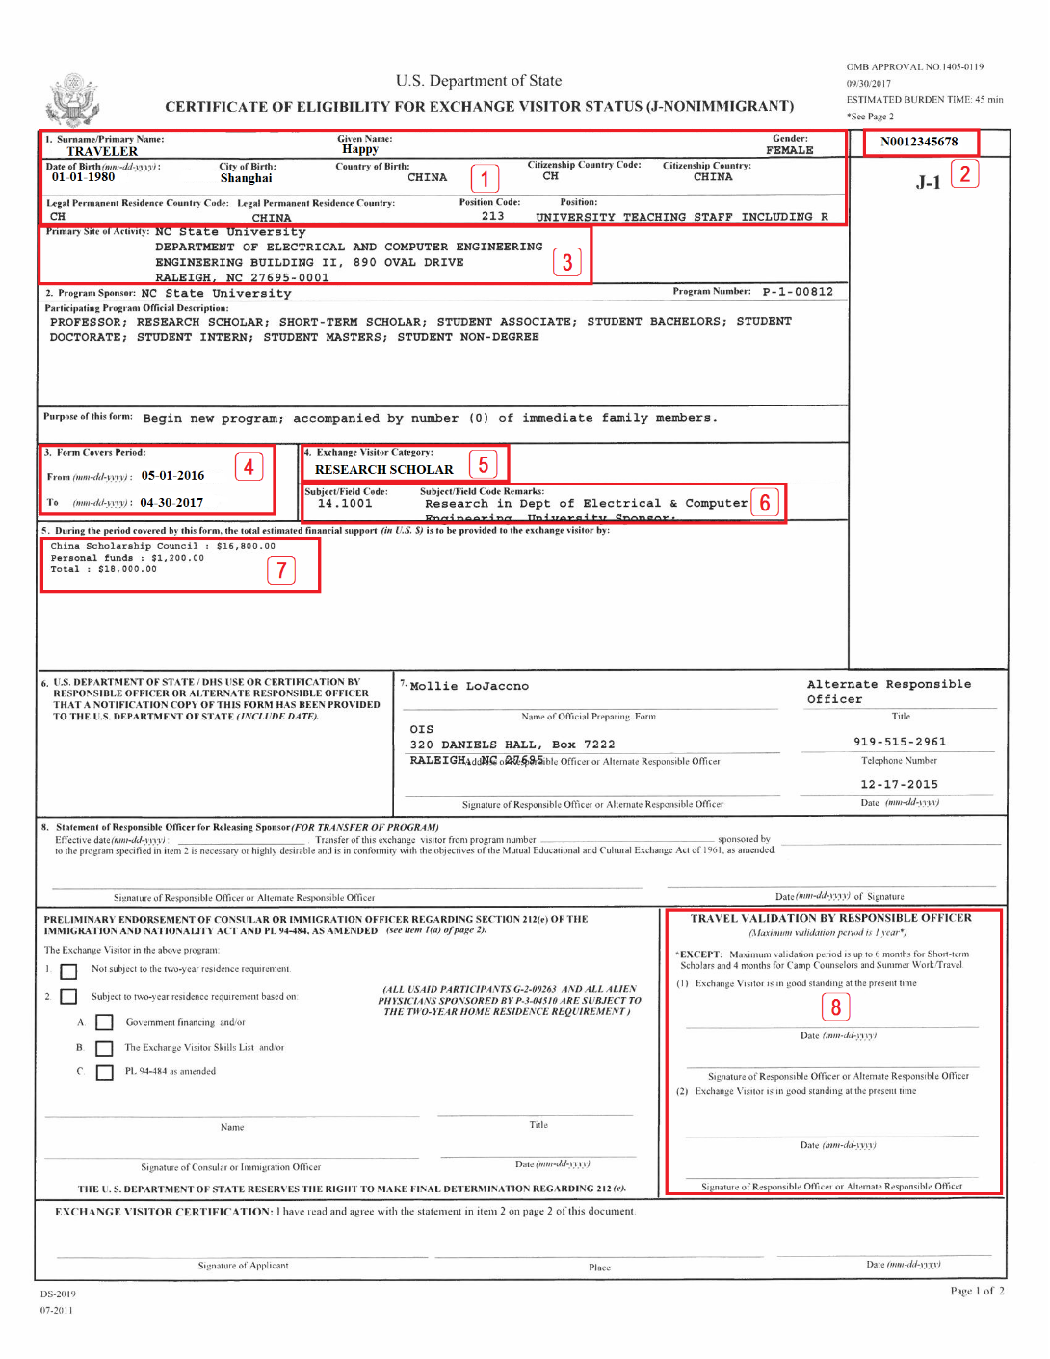
Important Documents: Certificate of Eligibility, DS-2019
The DS-2019 contains several pieces of important information.
  Biographical info
  SEVIS ID number
  Work location
  Validity dates
  J-1 Category
  Activity Remarks
  Funding Information
  Travel Validation section
It is important to make sure the DS-2019 is accurate at all times.
You must notify OIS if any changes to funding, dates, site of activity, program activities, etc. are needed.
All changes must be reviewed and approved by OIS in advance of the change.
OIS will issue an updated DS-2019 reflecting the change.
Notes:
Use DS-2019 form to discuss the need for funding updates and most important feature to discuss is the validity dates.

Slide 12
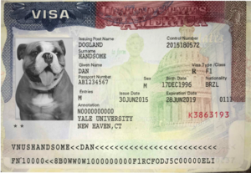
Important Documents: Visa
Visa allows you to apply for entry at a US port of entry.
Visa only needs to be valid to enter the US. It does not need to be valid for you to stay in the US.
If visa expires while you are in the US, it is ok (as long as your other immigration documents are still valid).
You can only obtain a visa abroad. It is not possible to renew your visa within the US.

Slide 13
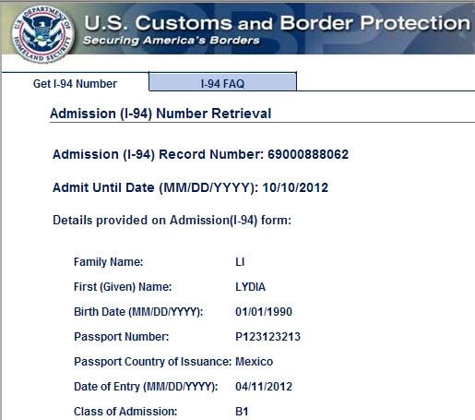
Important Documents: Electronic I-94
The I-94 is a record of your legal entry into the US.
Admit Until Date should say D/S (Duration of Status) for all J-1 visitors entering before September 15, 2026. After that date, visitors will have a specific date listed (the program end date plus 30 days)
D/S means the end date on your original DS-2019 plus a 30 day grace period.
Check visa validity type. Class of Admission should be “J1” for scholars and “J2” for dependents.
Download/Print your I-94 every time you enter the US to make sure it’s correct and notify OIS if there are errors or the record is missing.
D/S
Traveler
Happy
J1
Notes:
For I-94, emphasize for scholar to check validity type and D/S after “admit until date,” otherwise the scholar will not be eligible to work

Slide 14
Requirement to Carry Immigration Docs
We recommend making a small copy of the documents listed below to carry in your wallet or bag, as well as having digital copies on your phone. When traveling outside of the Raleigh area or when flying domestically, we recommend that you carry your original documents.
I-94
  This is your primary evidence of status in the US
Most recent DS-2019
Passport

Slide 15
Maintaining Status

Slide 16
Maintaining Your Status
It is your responsibility to maintain your status.
There are serious consequences for violating your status.
To maintain your status, you must:
Keep passport valid at all times. | Only participate in authorized activities for your J-1 program as specified on your most recently issued DS-2019.
Have an in-person, on-campus component to your program. | Notify OIS of anticipated programmatic changes and wait for OIS approval to make changes effective.
Depart by the end of the grace period which is 30 days after the DS-2019 end date. If you have a specific I-94 end date, you must depart by that date. | Maintain required health insurance for yourself and J-2 dependents for the entire length of your DS-2019.
Update OIS with your new address within 10 days of moving. | Maintain full-time active engagement in J-1 program during your J-1 program dates.
Do not engage in any unauthorized employment.

Slide 17
Maintaining Status: Authorized Activities
Authorized Activities
[always authorized] Authorized activities include: The specific activity noted on the DS-2019 (research, teach, intern, etc.) Under the supervision of the university sponsor noted on the DS-2019 At the site of activity noted on the DS-2019 In addition, you should participate in cultural and educational activities such as visiting a museum, going to a department social event, attending an OIS event, etc. You should be engaged in authorized activities at a full-time capacity (at least 30 hours a week). Authorized activities are only allowed during your DS-2019 dates. Do not continue them during the 30 day grace period.

Slide 18
Maintaining Status: Incidental Employment
Incidental Employment
[needs pre-authorization] J-1s in the Research Scholar and Professor category may be eligible for additional paid employment opportunities. Such employment must be authorized by OIS in advance. The activity must be directly related to the J-1’s program & cannot delay completion date of the program. Examples include honorarium for a guest lecture, reimbursement for travel expenses, conference participation, etc. To request authorization, follow the procedures on the OIS website and submit a Request for J-1 Incidental Employment form (requires login to GlobalHome) to OIS prior to engaging in the incidental employment activity.
Notes:
https://go.ncsu.edu/ois-incidental-employment

Slide 19
Maintaining Status: Unauthorized Activities
Unauthorized Activities
[NEVER AUTHORIZED] The following activities are never authorized for J-1s in the scholar and student intern categories: Full-time study Work in any activities or place other than what is listed on your DS-2019 Do not work at other NCSU departments/offices/units (i.e. NCSU Bookstore, Starbucks in Talley Student Union). Do not work at restaurants or businesses in the community (i.e. restaurants on Hillsborough or the Village District). Do not volunteer for jobs that are normally paid. Do not consult or give talks/lectures (even within your field) at other universities or institutions unless first approved by OIS. Engaging in unauthorized activities is a serious immigration violation and will result in termination of your J-1 program.

Slide 20
Maintaining Status: Immigration Violations
If you fail to maintain your status, there can be serious consequences, including termination.
NCSU is required to terminate J-1 Programs for those who commit certain immigration violations including the following:
  Working without authorization
  Willful failure to maintain health insurance for self and their J-2 dependents
If your J-1 program is terminated, it is not possible to get reinstated to valid status and you must depart the US immediately.
If your J-1 program is terminated, your J-2 dependents are also automatically terminated and must depart the US with you.

Slide 21
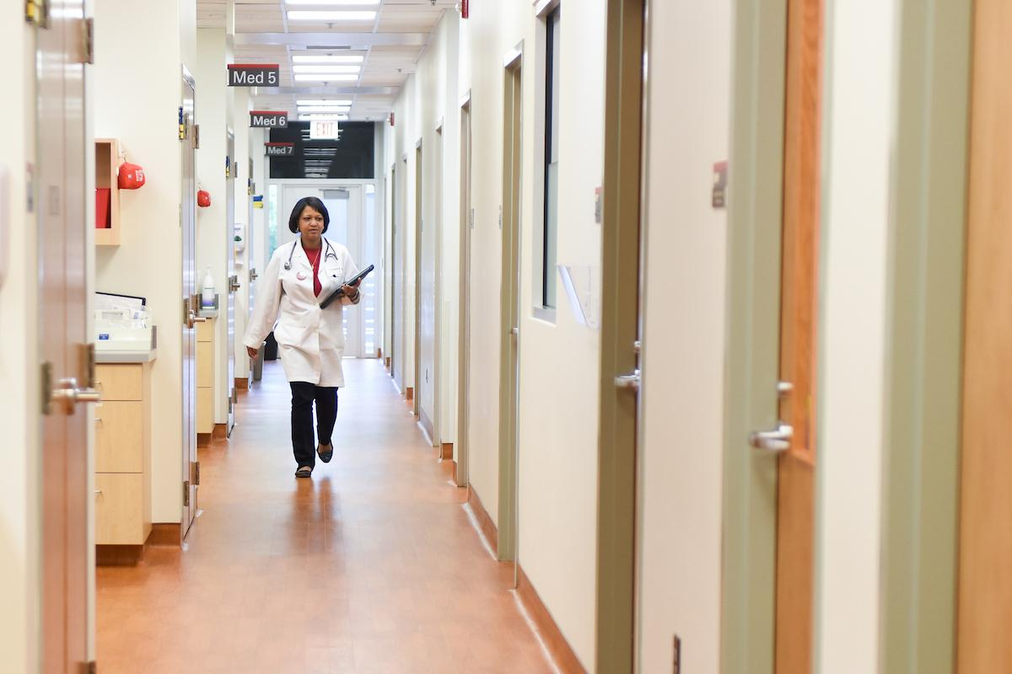
Maintaining Status: Health Insurance
It is a requirement of your J-1 Program to maintain adequate health insurance for yourself and any J-2 dependents for the duration of your program.
  Willful failure to maintain health insurance is considered a violation, which will result in termination from the program. It does not matter whether or not you are physically in the US.
  Dependents will also be terminated. There is no grace period. J-2 dependents must be covered for the entire length of the DS-2019. It does not matter whether or not they are in the US
  Do not forget to renew insurance if it will expire while you are here! OIS does not send reminders, so make sure to send proof of insurance as soon as you renew.
  OIS will check your insurance periodically when you apply for benefits such as an extension or travel signature.

Slide 22
Health Insurance
The minimum coverage levels are as follows:
  $100,000 per accident/illness.
  $50,000 medical evacuation.
  $25,000 repatriation.
  Deductible no more than $500.
  Coinsurance no more than 25%.

Slide 23
Health Care in the United States
Doctor’s Office | Urgent Care | Hospital
Non-emergency illness/injury Preferred preventative care method in the US Used to establish provider before illness occurs or manage long-term conditions Choose one within health insurance “network” | For sudden/potentially serious illness or injury (i.e. food poisoning, flu, sprained ankle) Flat rate fee depending on insurance Night and weekend hours Used when doctor’s office is closed | Emergencies (i.e. very high fevers, appendicitis, broken limb) Outpatient and Inpatient Surgeries Most expensive Open 24 hours a day 365 days a year

Slide 24
Emergency Information
In case of an emergency for health, fire, safety, dial 911 in any state in the US.
  NC State Campus Police: (919) 515-3000
Be sure to have the address or location you are calling from to provide to the operator.
911 will send an ambulance, police patrol car, or fire truck (or any combination of these) depending on the nature of the situation.

Slide 25
Safety
In general, NC State and Raleigh are safe. However, we do have some general tips to stay safe and minimize risks:
Beware of phone and email scams (opens in new tab) as international scholars/students are often targeted.
  The US government will never call or email you to ask for money and threaten to deport you if you don’t pay.
  If you get a call/email like this, inform OIS immediately so we can report it.
Be aware of your surroundings, especially if you are walking alone in an unfamiliar area. If you are lost, try to step into a well lit, public place where you can check your directions.
Do not leave valuables in public places, such as leaving a laptop unsecured in the library or saving a table with a wallet/phone.
Police officers are here for your safety. They are also an authority figure. If you are pulled over by a police officer while driving your car, wait in your car for the officer to approach you and follow any instructions given to you by the police officer.

Slide 26
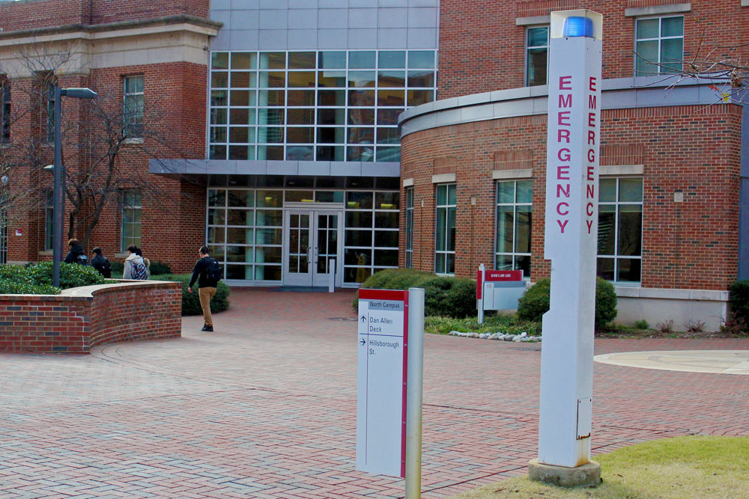
Safety on Campus
Bluelight emergency call boxes are strategically located on campus to provide assistance or to contact the NC State University Police Department’s 911 Center. When you use these emergency call devices an Emergency Communications Officer will know your exact location.

Slide 27
Reporting Incidents
If you or a dependent experience any of the following, please let OIS know! OIS needs to know so that we can help you navigate these situations and make sure you have the resources you need!
Serious illness or injury
Legal proceedings
Incident where a police report was filed
Car accidents
Hospitalizations of 48 hours or more
Notes:
Mention that this goes for any dependents as well.

Slide 28
Bars and Home Residency Requirements

Slide 29
12 and 24 Month Bars
Research Scholar/Professor Category | Student Intern Category | Short-Term Scholar Category
Subject to a 24 month bar on repeat participation | Subject to a 12 month bar for the research scholar/professor category if their program is longer than 6 months | Not subject to a 12 month or 24 month bar
Example: A J-1 Research Scholar who did research for 3 years at NC State and their DS-2019 ended on Dec. 1st, 2023. They cannot return as a J-1 Research Scholar again for 24 months (after Dec. 1st, 2025). | Example: A J-1 Student Intern who interned for 8 months at NC State had their DS-2019 end June 1st, 2020. They cannot come back as a J-1 Research Scholar until after 12 months have passed (after June 1st, 2021). | Example: N/A
◆ Being subject to the 12 or 24 month bar only impacts future J-1/J-2 eligibility in the Research Scholar/Professor categories; it does NOT prevent you from returning to the US as a tourist (B) or student (F).

Slide 30
Two-Year Home Residency Requirement
If you are subject to the two-year home residency requirement (opens in new tab), there should be a notation on your DS-2019 and/or J-1 visa. This is also called “212e”.
If you are subject, you cannot change your status within the US or apply for
H visa
L visa
K visa, or
Permanent Residency until you have either:
  Fulfilled the 2 year home residency requirement by residing in your home country for 2 years
  Or obtained a waiver of that requirement
If you obtain a waiver of the 2 year home residency requirement, you can no longer extend your DS-2019 and international travel may be difficult. Do not apply for a waiver without talking to OIS first so we can advise you of the immigration consequences!
◆Being subject to the 2 Year Home Residency Requirement does NOT prevent you from returning to the US as a tourist (B) or student (F).
Notes:
http://internationalservices.ncsu.edu/212e-two-year-home-country-physical-presence-requirement

Slide 31
Two-Year Home Residency Requirement:
DS-2019
DS-2019 presented at visa interview will show whether subject to 212(e)

Slide 32
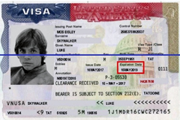
Two-Year Home Residency Requirement:
Visa Stamp
The annotation on your visa will also indicate whether or not you are subject to 212(e). “Bearer is subject to 212(e)”; “Two-year rule does apply”; etc.
If there is a discrepancy between the determination on your visa and your DS-2019 for your visa interview, please consult with OIS. Errors do occur. When there is significant doubt, an Advisory Opinion (opens in new tab) may be requested from the Department of State for a formal decision.
Notes:
https://travel.state.gov/content/travel/en/us-visas/visa-information-resources/advisory-opinions.html

Slide 33
Important Processes

Slide 34
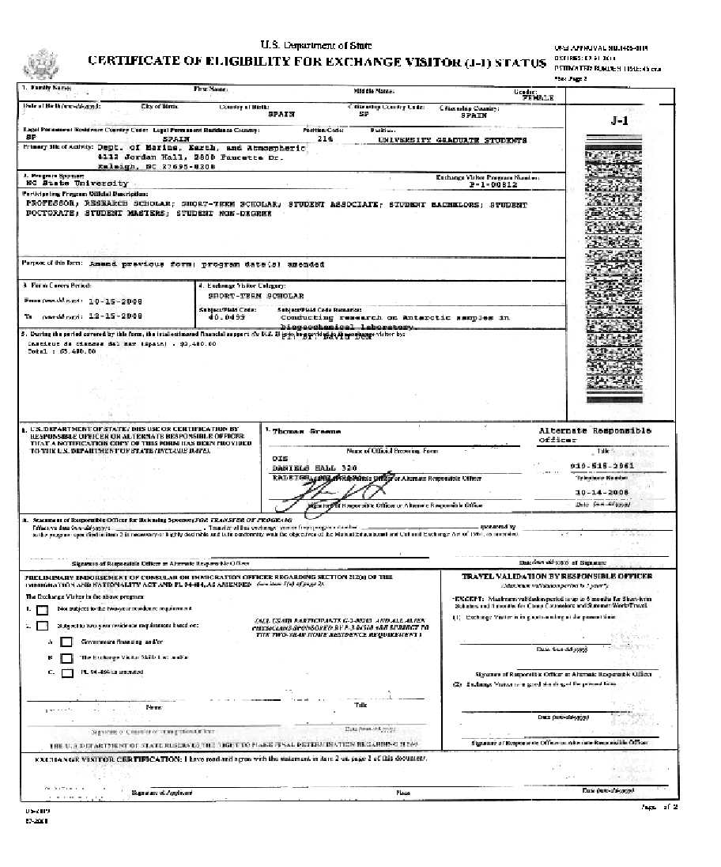
Important Processes: Travel During J-1 Program
Documents required for international travel in J-1/J-2 status:
Valid passport with at least 6 months validity remaining
Valid J-1 visa
I-94 electronic print out
DS-2019 with valid travel endorsement from OIS
  Endorsements are valid for 12 months
  Complete travel authorization form in GlobalHome to request a travel signature
  OIS will check your insurance and email a signed DS-2019 within 10 business days.
Some important guidelines:
Please consult the OIS travel page (opens in new tab) and talk to OIS prior to any international travel.
You may need a visa to enter another country. Please contact that country’s embassy for visa information.
An absence from the US for more than 30 days can jeopardize your J-1 status.
For any travel 30 days or longer, your J-2 dependents must travel with you.
Print your new I-94 when you return and check it for errors.
If you travel abroad and return after Sept 15, 2026, you will get a specific date on your I-94 (program end date plus 30 days)

Slide 35
Important Processes: Extend
Extend a J-1 Program
Need extra time to complete your research? Total time is based on your J-1 Category: Short-Term Scholars = 6 months Research Scholars = 5 years Student Interns = 12 months To extend, please inform your supervisor and department personnel representative you need an extension. Your department will submit the extension request to OIS. OIS will then issue a new DS-2019 form for you. Extension requests should be submitted by your dept at least 30 days before to your program end date. You cannot request an extension in your grace period! Extensions submitted after Sept 15, 2026, will also require that you submit an Extension of Stay (form I-539) with USCIS and pay the corresponding filing fee ($420 if filing online).

Slide 36
Important Processes: Shorten
Shorten a J-1 Program
Finished early? You must notify OIS if your program/project/research ends early. This includes cases where there is loss of funding. OIS will shorten your DS-2019 end date to reflect the accurate end of your program. You will have a 30 day grace period after your program end date even after you shorten your program. Fill out the Departure Form (requires login to GlobalHome) prior to your departure.

Slide 37
Important Processes: Transfer
Transfer a J-1 Program
Have an opportunity at another university? Exchange visitors may continue their original program objective with another J-1 sponsor in the US by transferring their SEVIS record to a new sponsor. The J-1 sponsor must be approved by the Department of State to sponsor the same J-1 category. The Program objective or activity may not change. Your NSCU department must agree with the transfer and it must be requested prior to the DS-2019 end date. Period of program will not exceed maximum Department of State established period. Submit the transfer out form to OIS no later than 30 days before desired transfer date. You must check in with your new sponsor immediately following the transfer date.

Slide 38
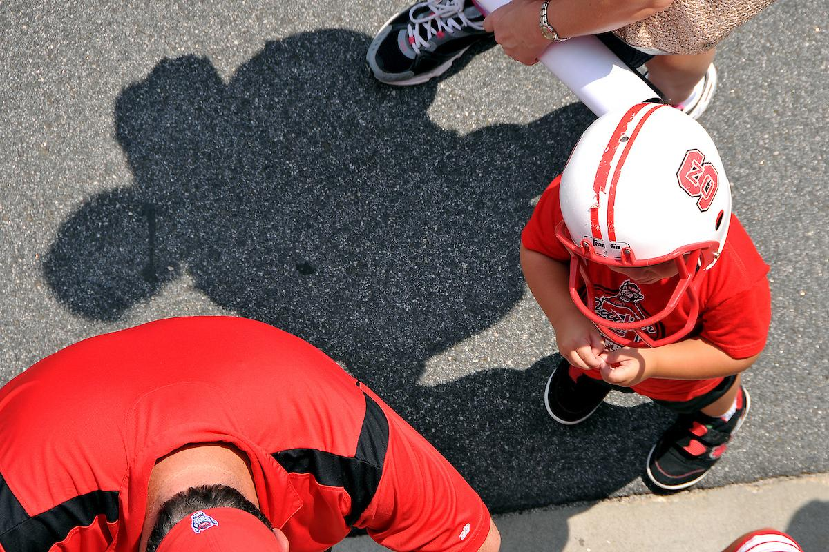
Your Dependent’s Status
J-2 dependents are subject to all restrictions the J-1 is subject to (i.e. bars, 2 year home residency requirement, etc.).
J-2 maintains status only if you maintain status as a J-1.
Changes made to your J-1 program will apply to the J-2.
J-2 dependents must maintain at least the minimum health insurance standards required by law for the entire length of their DS-2019 (regardless of where they are physically located)
A J-2 cannot work unless they have applied for, and received, an Employment Authorization Document (EAD) from USCIS. USCIS processing time is about 90 days.
The age limit for a child to remain a J-2 dependent is 21-years-old and they must be unmarried.
All J-2 dependents must complete a check-in with OIS. To schedule a J-2 check-in, please visit the section of our website on dependents and families (opens in new tab).

Slide 39
Administrative Tasks for
Daily Life

Slide 40
Social Security Numbers
A Social Security Number (SSN) is a tax identification number.
J-1 Exchange visitors who are receiving funds from NC State (as indicated on the DS-2019), are eligible to apply for a Social Security Number.
You must wait at least 10 days after entering the US and at least one week after checking in with OIS before visiting the local SSA office.*
J-2 dependents are only eligible for an SSN if they have applied for employment authorization with USCIS and received the EAD card.
The Social Security Administration requires you to complete an online application and then schedule an in-person appointment with the local SSA office. Please visit our webpage on the Social Security Process to get started (opens in new tab).
*Short terms scholars who will receive income from NCSU & will reside for at least 15 days but no more than 29 days should not wait to apply for an SSN. They must apply for a SSN immediately after arriving in the US.
Notes:
http://internationalservices.ncsu.edu/social-security

Slide 41
Taxes
In order to get a tax assessment, send an email to International Compensation and Taxation at ICTquestions@ncsu.edu.
They will request documents and set up a secure portal using Sprintax Calculus. This process does not require any "real time" interaction or appointment.
Additionally, anyone who receives compensation through NC State University or a US entity may have to file an annual tax return in the spring with the IRS. For more information, please visit OIS’ webpage on taxes (opens in new tab).

Slide 42
Obtaining a NC Driver's License
If you plan to drive in the US, you should apply for a driver’s license at the Department of Motor Vehicles (DMV). You must wait at least 10 days after entering the US & at least one week after checking in with OIS before applying.
  The DMV office is located at 3231 Avent Ferry Road
  The DMV website is www.ncdot.gov/dmv
If you don’t plan to drive, you should apply for a State ID at the DMV.
  Use your driver’s license/state ID as your main ID. Keep your passport at home while in Raleigh.
J-1 Scholars do not need a Social Security Number to get a driver’s license/state ID. However, if you already have one, you must show proof of it.
You are required to have car insurance if you drive or own a car in the US. For more information about insurance and driving cars in the US, visit our webpage on driving in the United States (opens in new tab).

Slide 43
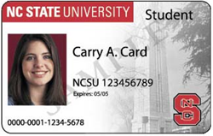
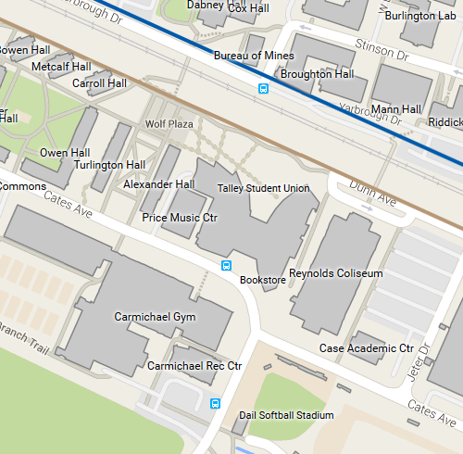
Campus ID Card
Talley Student Union
Hours: 8AM-5PM
    Library Privileges
    Access to Carmichael Gym if you pay for membership
    “All Campus” account allows you to use card at NC State dining & food services
Dependents may receive campus ID card after attending OIS Dependent Check-In ($25)
Additional fees may apply

Slide 44
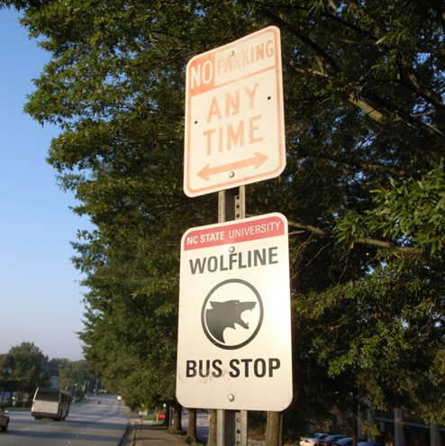
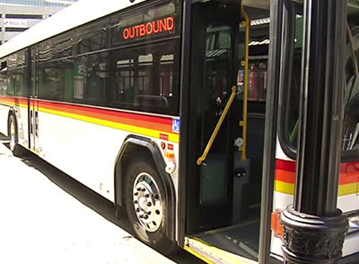
Transportation
  Wolfline (NC State bus line) to get around campus
  GoPass (opens in new tab) allows you to ride for free:
    GoRaleigh (Raleigh bus line)
    GoTriangle (Triangle regional bus line)
  Riders will need to board buses using the
  UMO Mobile app, UMO Card, or cash (exact)
  You can download the app to see all bus lines: Passio Go! App

Slide 45
Life in the US and at
NC State

Slide 46

Participation in cultural activities is a requirement of the J-1 Program.

Slide 47
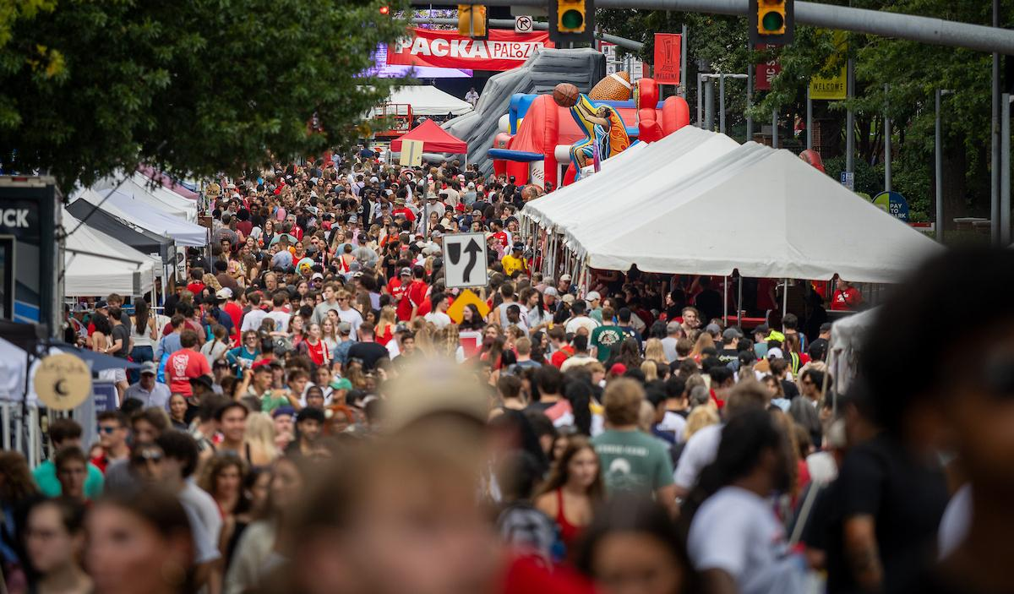

Discussion:
What does it mean to get involved with US culture?
Notes:
Using involvement to learn US culture

Slide 48
Getting Involved in Raleigh and the Area
Spring/Summer | Fall | Winter
Packapalooza Day Trips to the Beach Dorothea Dix Park NC Museum of Art Farmer’s Market JC Raulston Arboretum | North Carolina State Fair BugFest Day Trips to the Mountains Halloween Pumpkin Picking Corn Mazes Umstead State Park | Ice Skating in Downtown Raleigh Chinese Lantern Festival in Cary Holiday Express in Pullen Park Carolina Hurricanes Hockey Krispy Kreme Challenge

Slide 49
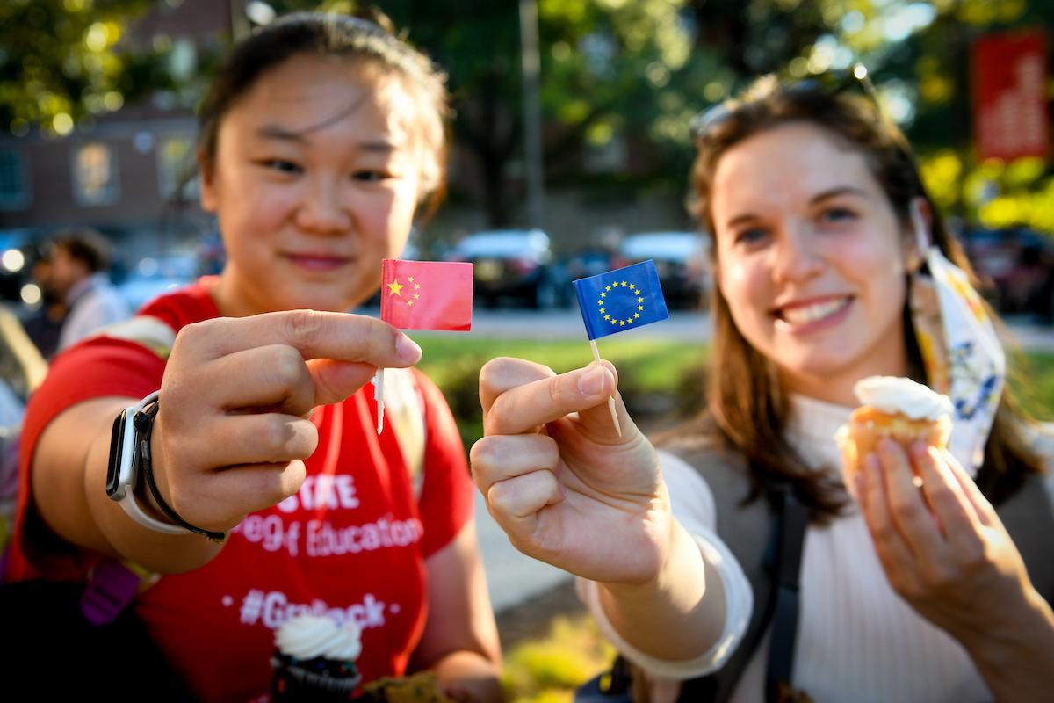
OIS Programs
OIS offers opportunities to enrich your cultural experience. If the event is off-campus, we provide transportation!

Slide 50

English Conversation Club
Summer 2026
Tuesdays and Thursdays – 4:30 PM to 5:30 PM
  Engineering Building I, Room 2015 (Centennial Campus)
For the most up to date location and schedule, please visit our website here (opens in new tab).

Slide 51
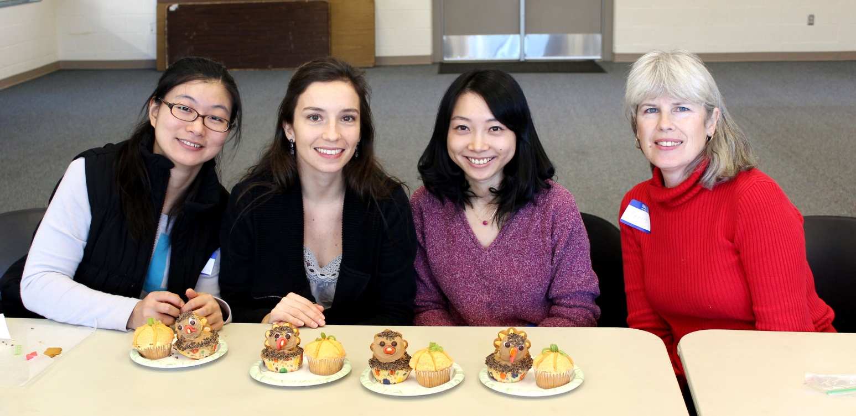
I.M.O.M
(International Moms or Mates)
Wednesdays at 1:30 p.m. – 3:30 p.m.
ES King Village
For the most up to date information, please visit our website here (opens in new tab).
Notes:
If there are questions scholar or dependent should email Lauren at ldball@ncsu.edu
https://internationalservices.ncsu.edu/ois-programs/i-m-o-m/

Slide 52
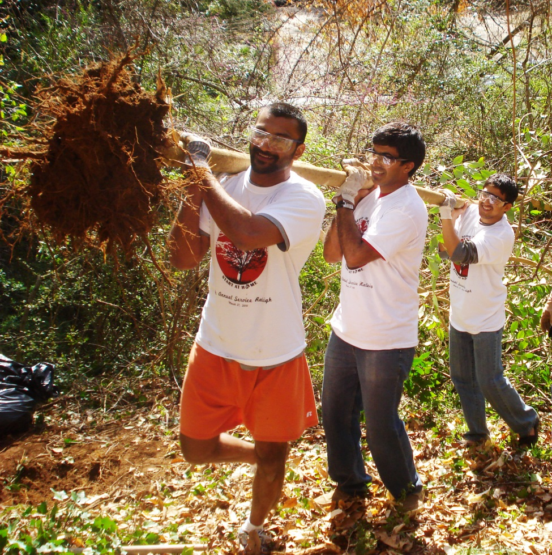
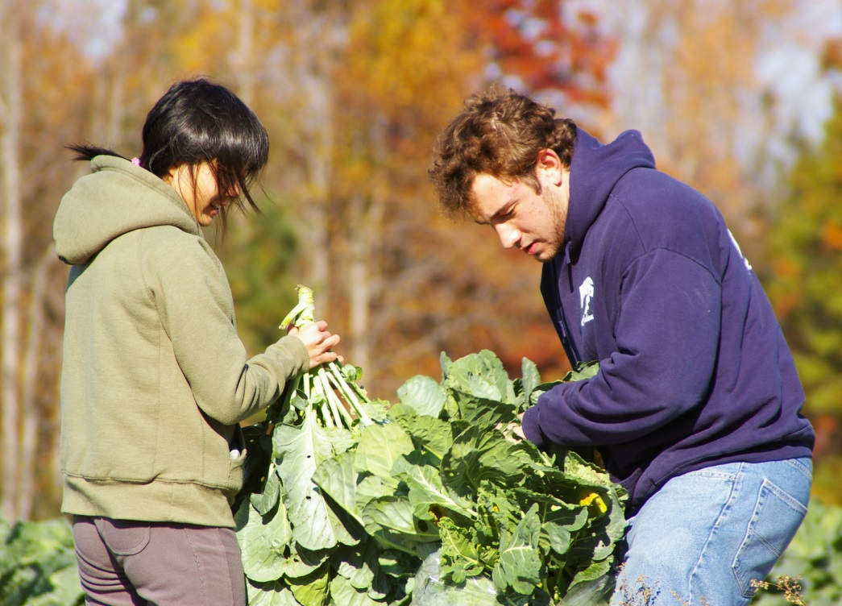
ISSERV
Participate in service projects at NC State
and in the community. For the most up to date information, please visit our website here (opens in new tab).

Slide 53
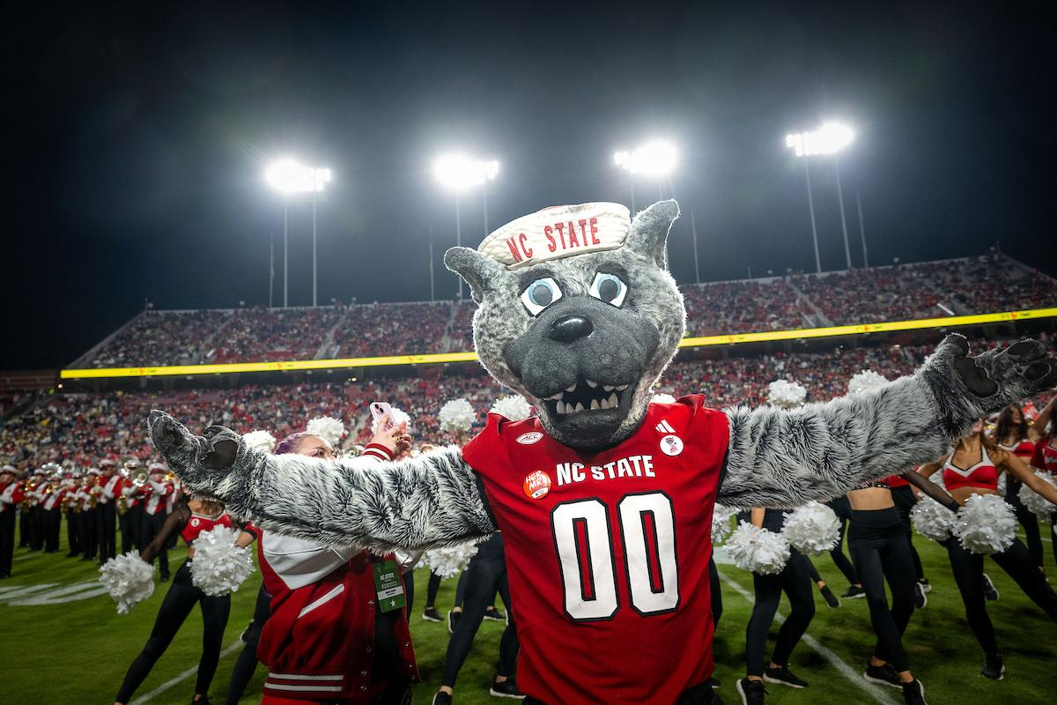
Welcome to NC State:
A Summary
Familiarize yourself with your J-1 immigration status. If you have any questions, visit the OIS website or consult an OIS advisor.
Do not rely on friends for immigration advice. Get your immigration advice from an immigration advisor at OIS. We are happy to help!
Participate in cross-cultural programs and events with OIS or in the community!

Slide 54
Additional Resources
Department of State Video on US Campus Culture
(opens in new tab)
Fermilab’s Life and Customs in the US
(opens in new tab)
eduPASS’ Living in the USA (opens in new tab)
Cultural Vistas’ Culture in the US Workplace
(opens in new tab)

